Slide 1
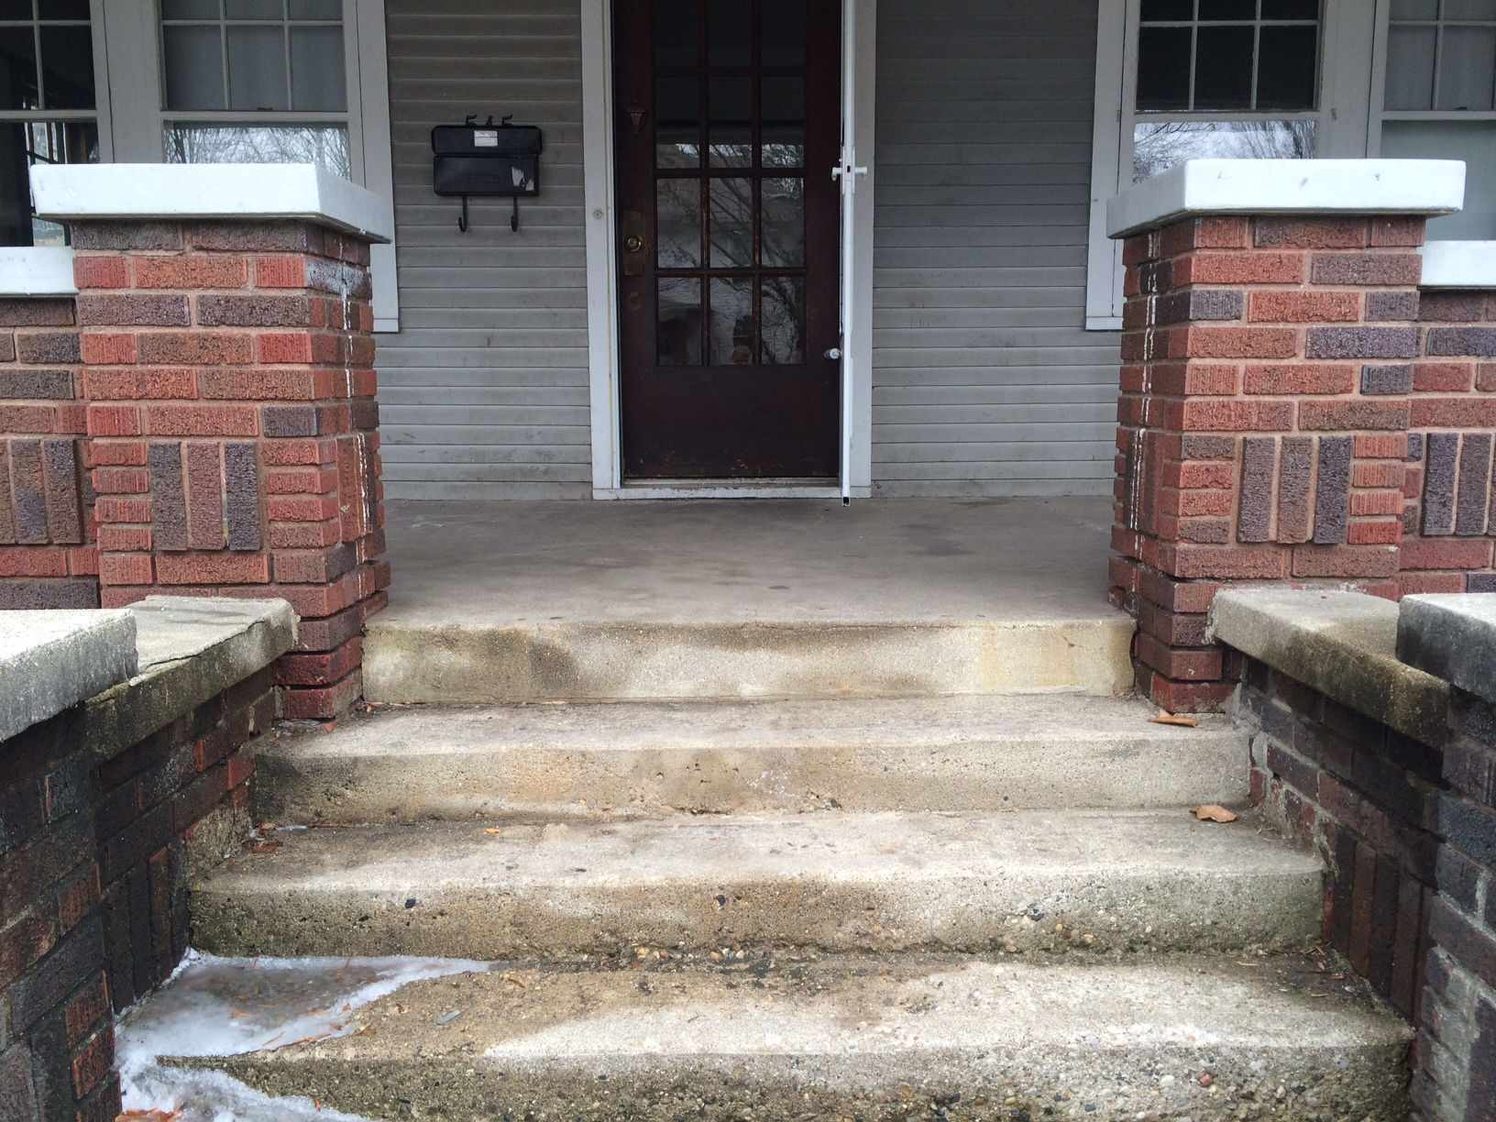


“
“
Mission: Transform an existing home into a world class research laboratory and sustainable living showcase.
Read more in About Us.
Retrofit Net Zero: Energy. Water. Waste.
“
“
Mission: Transform an existing home into a world class research laboratory and sustainable living showcase.
Read more in About Us.
Retrofit Net Zero: Energy.Water.Waste.

Slide 2
“
Re
trofit
“
Mission: Transform an existing home into a world class research laboratory and sustainable living showcase.
Read more in About Us.

